Slide 1
SCT 2022
Business Session

Slide 2
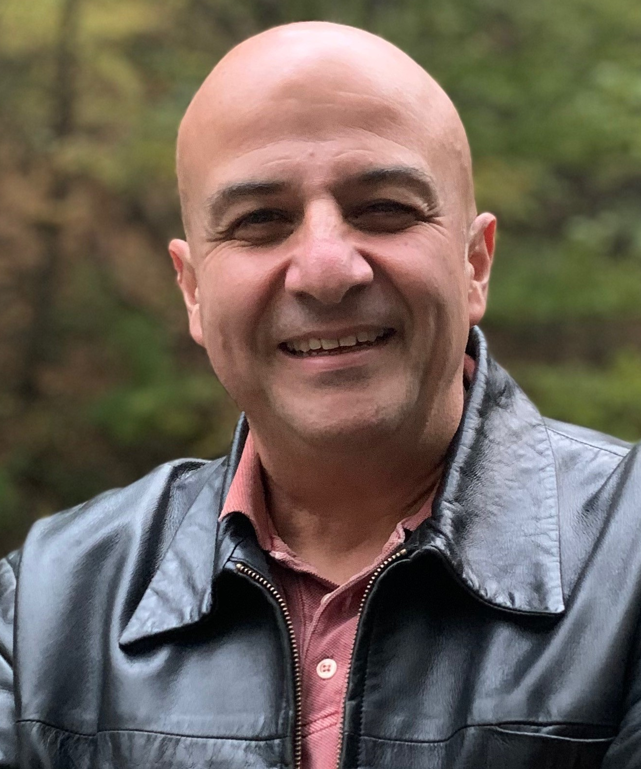
President’s Welcome and Report
Mithat Gönen
SCT 2021-2022 President

Slide 3
Approval of
2021 Business Meeting Minutes

Slide 4
Year-in-Review

Slide 6
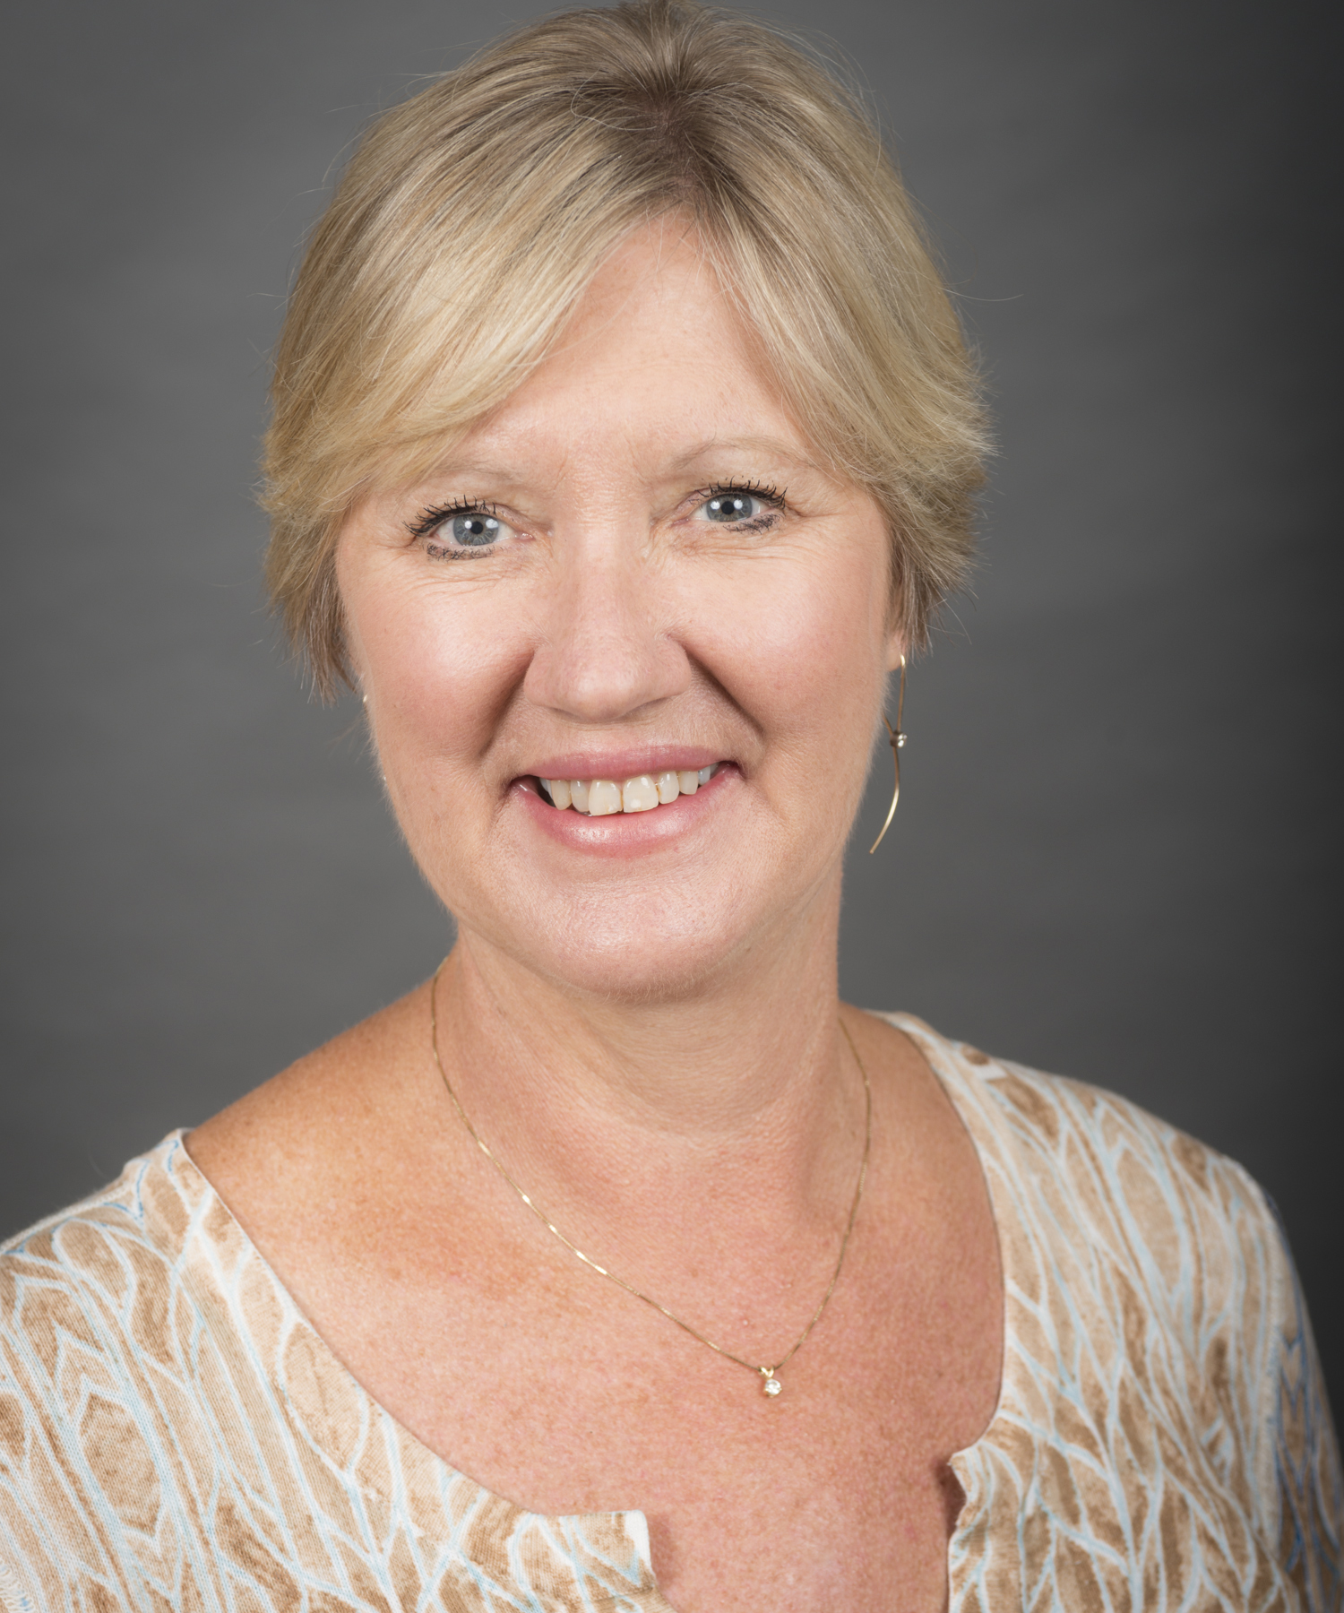
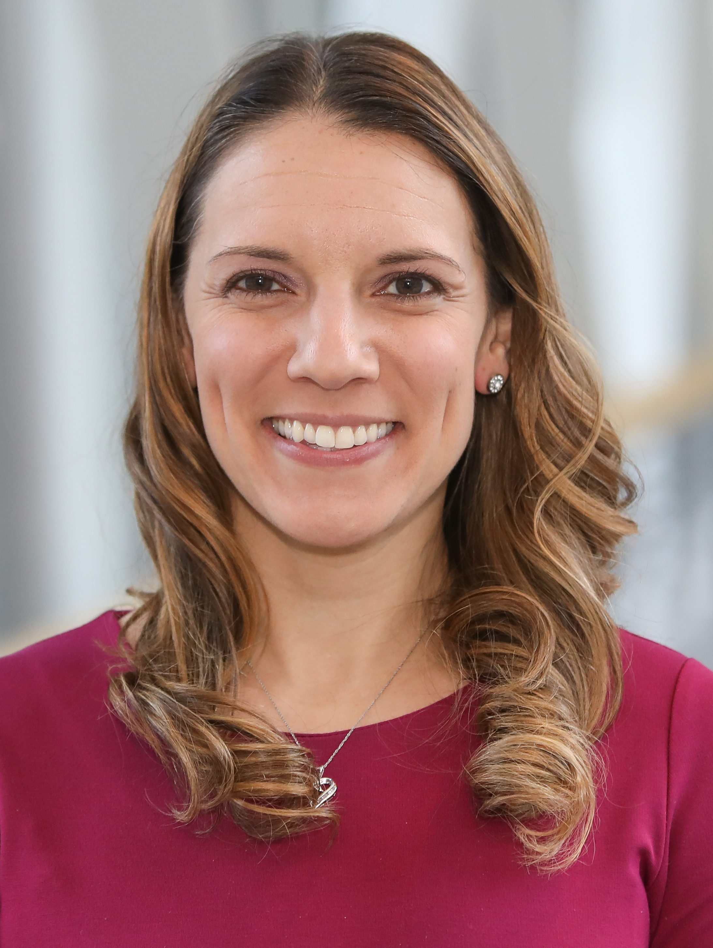
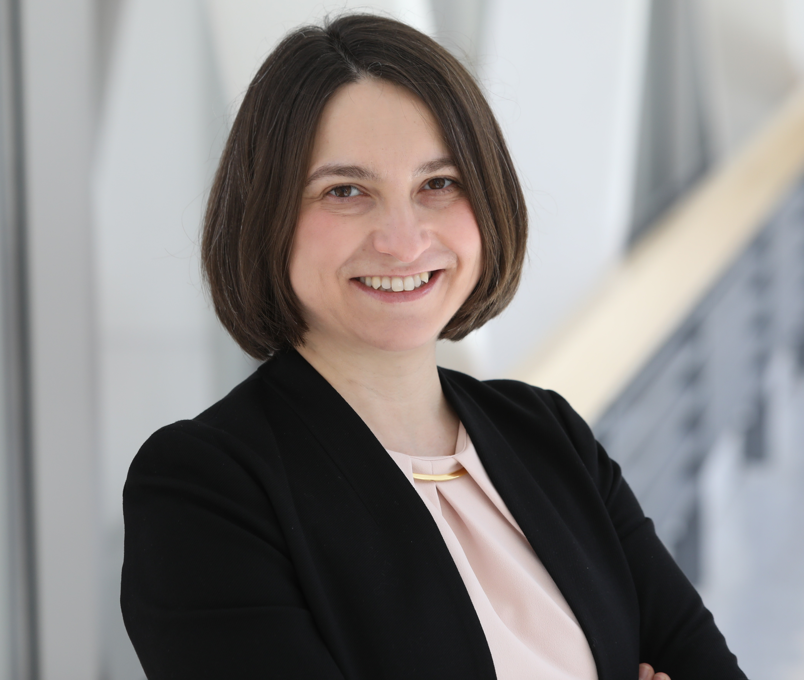
Election Results
President-Elect
Dixie J. Ecklund, BSN, RN, MSN, MBA, CCRC
University of Iowa
Board of Directors
Jody D. Ciolino, PhD
Northwestern University
Board of Directors
Masha Kocherginsky, PhD
Northwestern University

Slide 7
Financial Report

Slide 10
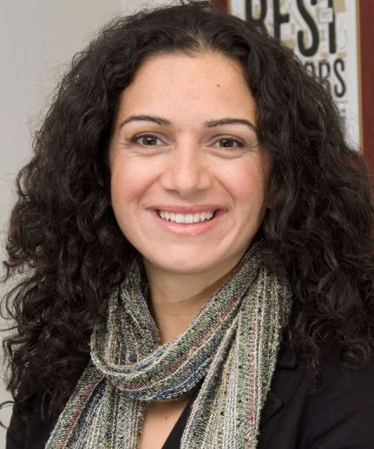
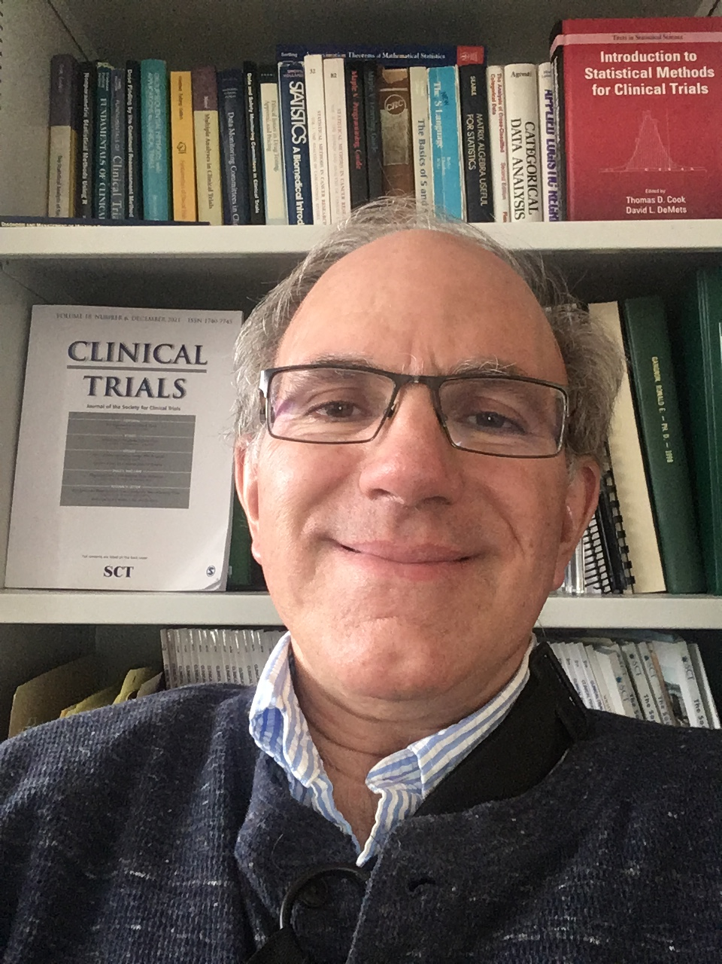
Class of 2022 Fellows
Thomas Cook, PhD
University of Wisconsin, Madison
Alexia Iasonos, PhD
Memorial Sloan Kettering
Cancer Center

Slide 11
Clinical Trials Journal Report

Slide 12
Membership Committee
Update

Slide 13
Communications Committee
Update

Slide 14
Student Scholarship Committee
Mission: The mission of the Committee is to enhance students' participation in order to broaden the Society’s membership.
Scope: The overall scope of the Committee is to review abstracts, manuscripts, and presentations submitted by students to the annual meeting.
2021-2022 Committee Members:
Cody Chiuzan (Chair) Northwell Health
Michael Grayling (Co-Chair) Newcastle University
Marcin Dudek University of Warsaw
Denise Esserman Yale University
Liz Garrett-Mayer American Society of Clinical Oncology
Yu Lan Farallon Capital
Ruitao Lin MD Anderson Cancer Center
Chaoqun Mei Pfizer
Ludovic Trinquart Tufts Medical Center
Xiaofei Wang Duke University

Slide 15
Student Scholarship Committee
Thomas C. Chalmers Student Scholarship
Students currently enrolled in a graduate program (MS, PhD, or DrPH)
Post-doctoral fellows (2 years from completing PhD/DrPH)
Submission of short manuscript (≤3500 words)
26 applications received in 2021-2022
Sylvan Green Award
Physicians, dentists or other health professionals engaged as investigators or co-investigators in clinical trials or epidemiology projects
Submission of short paper (≤1000 words)
2 applications received in 2021-2022

Slide 16
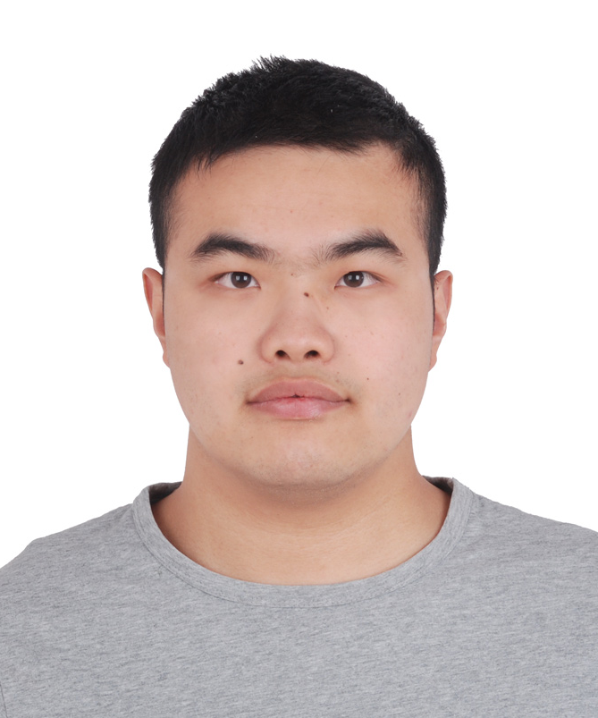
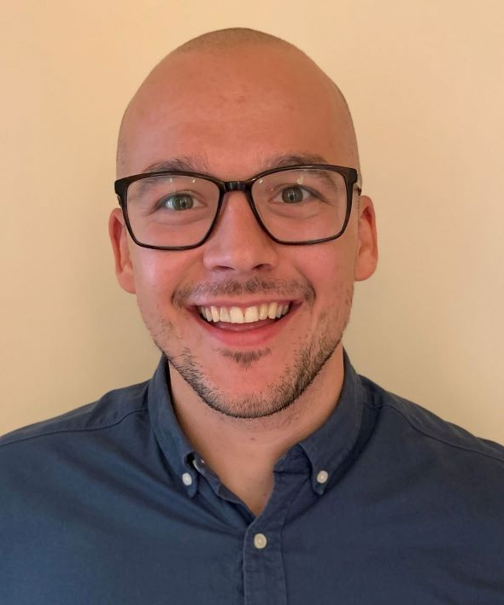
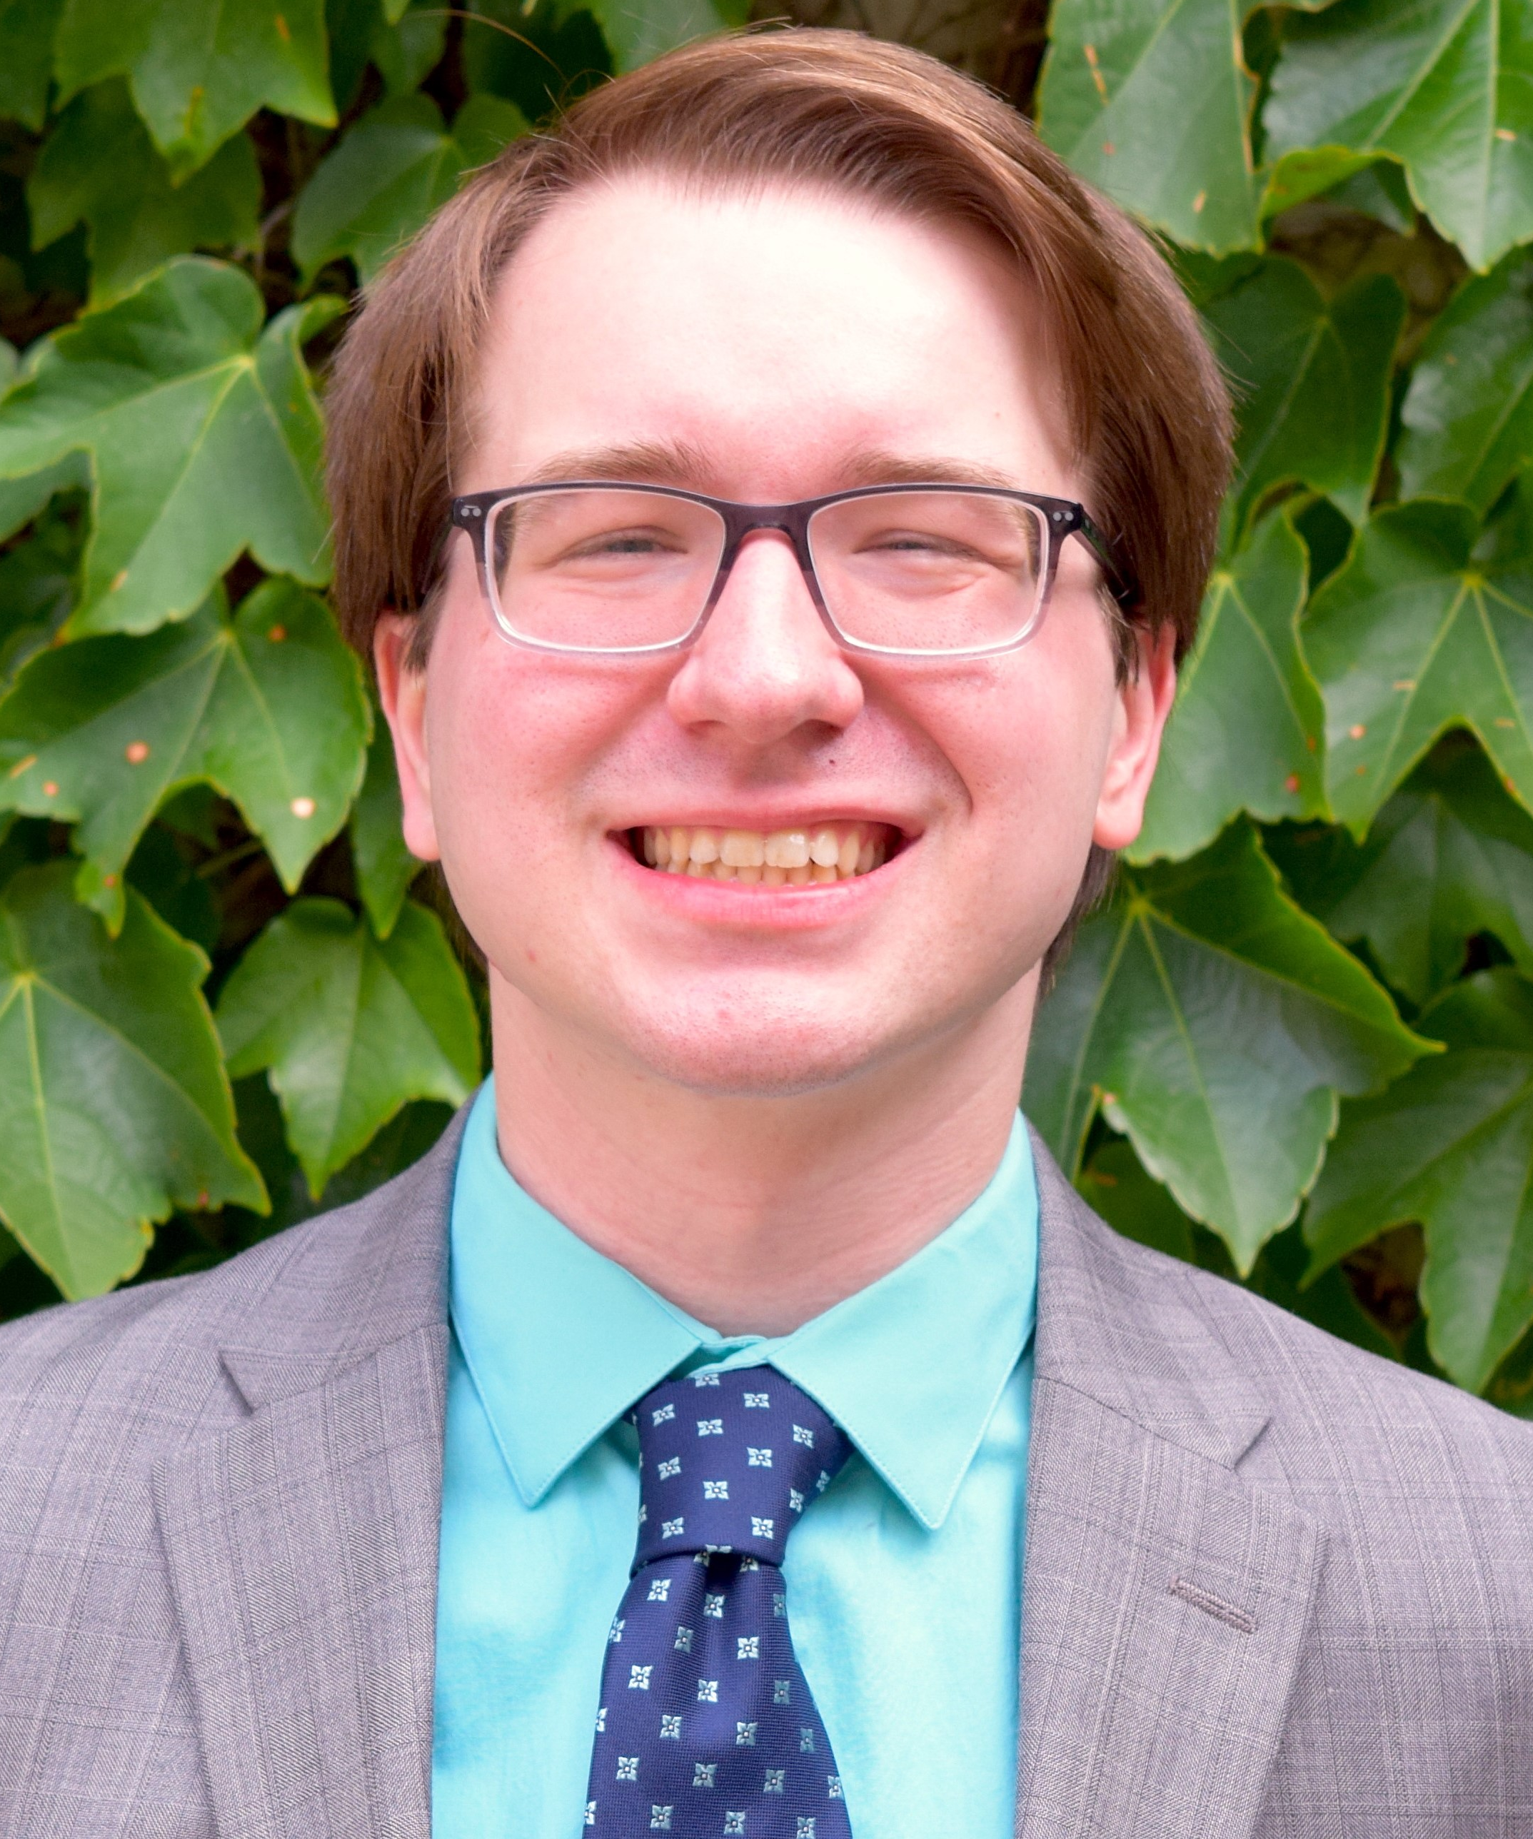
Thomas C. Chalmers Student Scholarship Finalists
Jiyang Wen
Johns Hopkins Bloomberg School of Public Health
Peter Godolphin
University College London
Jack Wolf
University of Minnesota School of Public Health

Slide 17
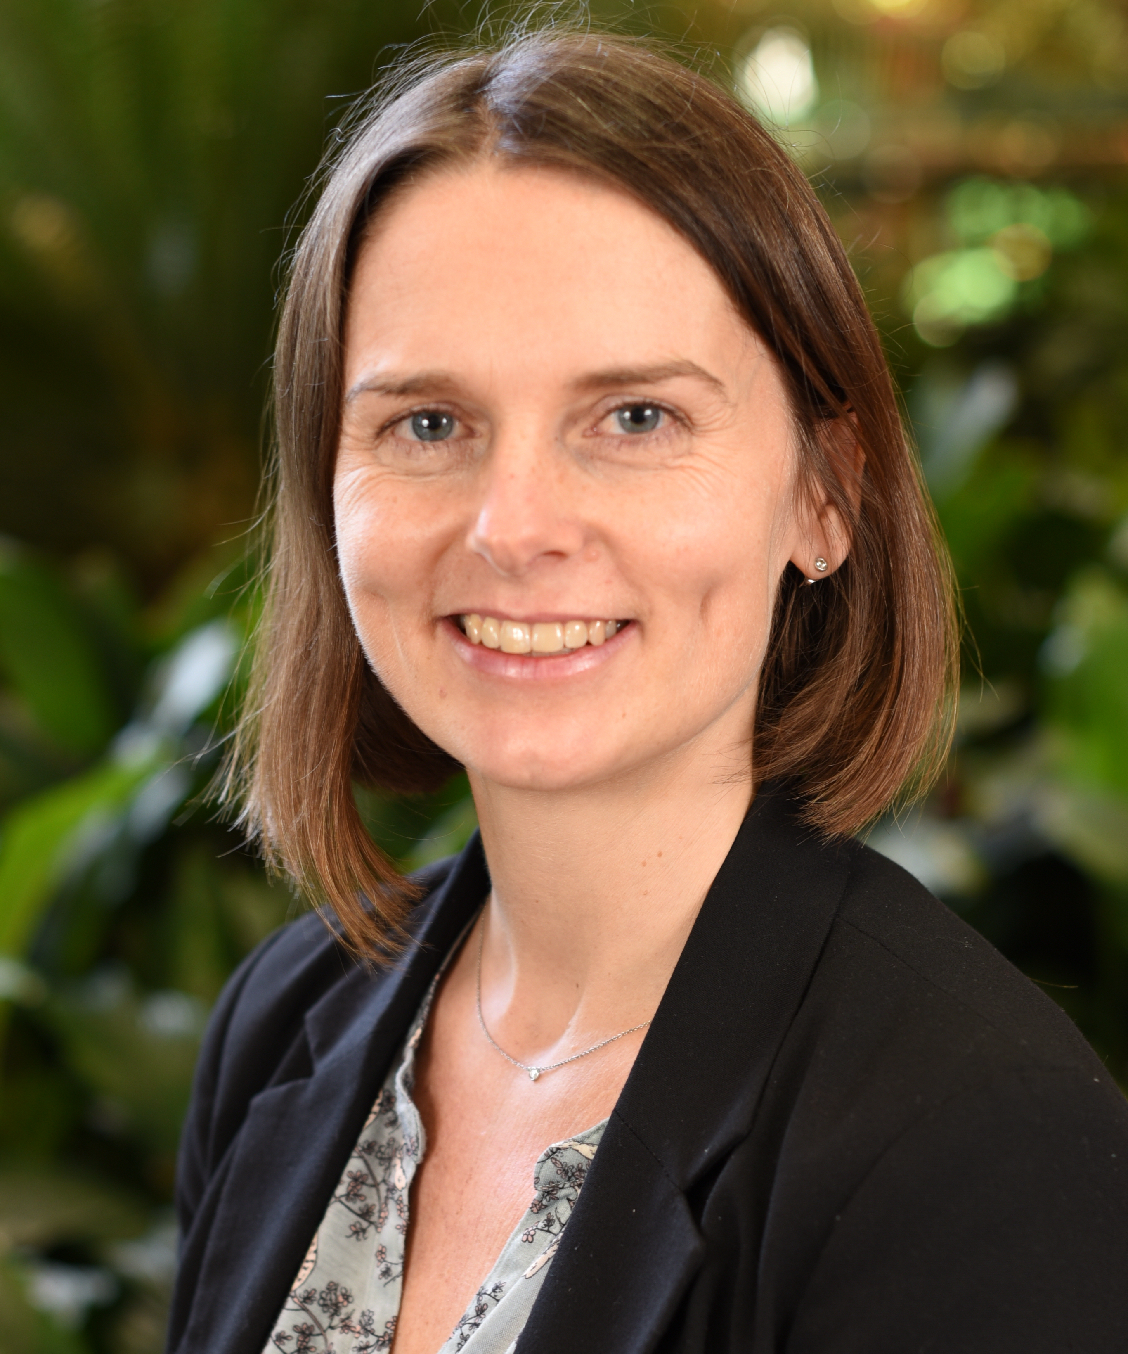
Sylvan Green Winner
Andrea Viecelli
Princess Alexandra Hospital

Slide 18
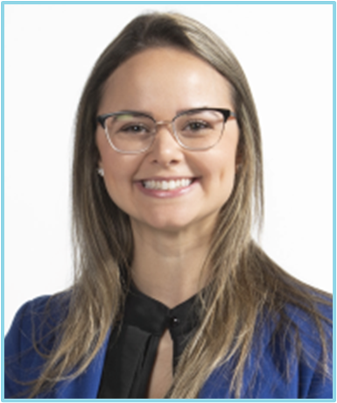
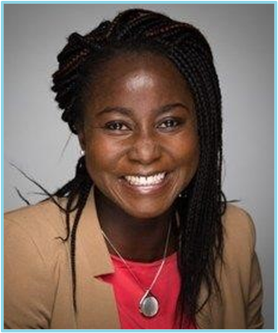
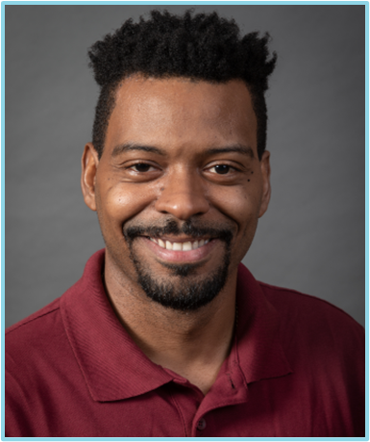
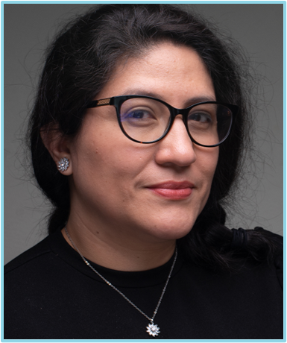
ED&I Student Travel Awards
Ariany Marques Vieira
Jacqueline Thompson
David-Erick Lafontant
Sandra Castro-Pearson

Slide 19
Best Poster Presentations

Slide 20
Remarks from Incoming President
Awards to Outgoing Board Members and President
2023 Annual Meeting: May 21 -24, 2023, Baltimore, MD

Slide 21


Slide 22
Closing Remarks
Open Discussion / Q&A
Adjournment

